Slide 1

Brain inspired computing
using a FPAA Board
3rd week catch-up session
Discovering the Analog Discovery 2 tool and the Hodgkin Huxley neuron model
Matthieu Divet
Jonathan Gomis
Annie Luo
Anonto Zaman
Special problem
ECE 8903
Dr. Alexandre Locquet
Dr. Damien Rontani

Slide 2
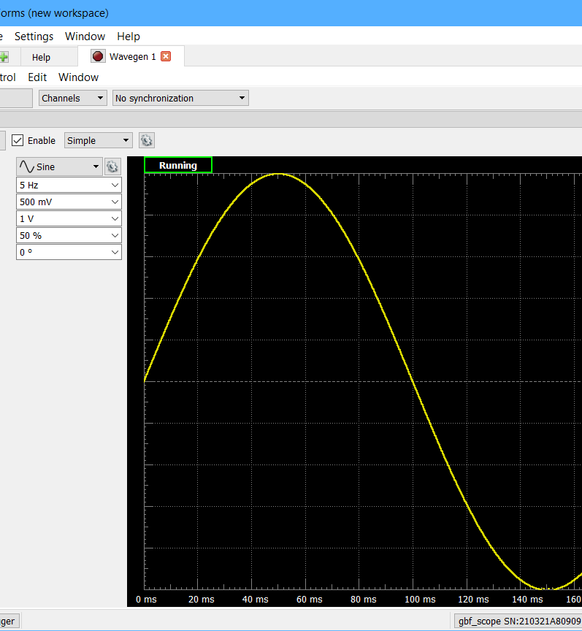
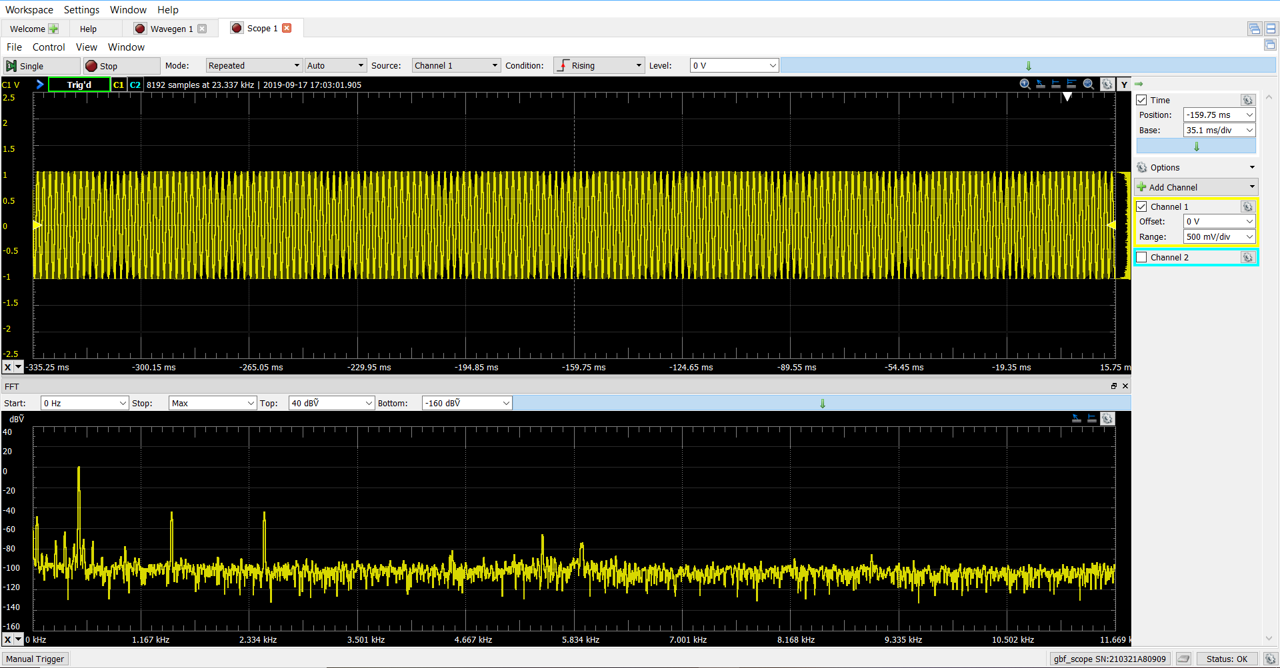
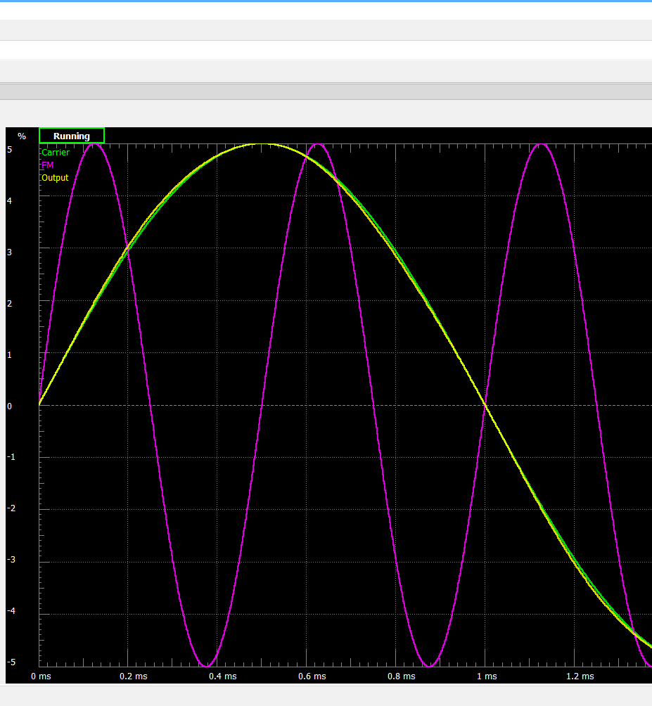
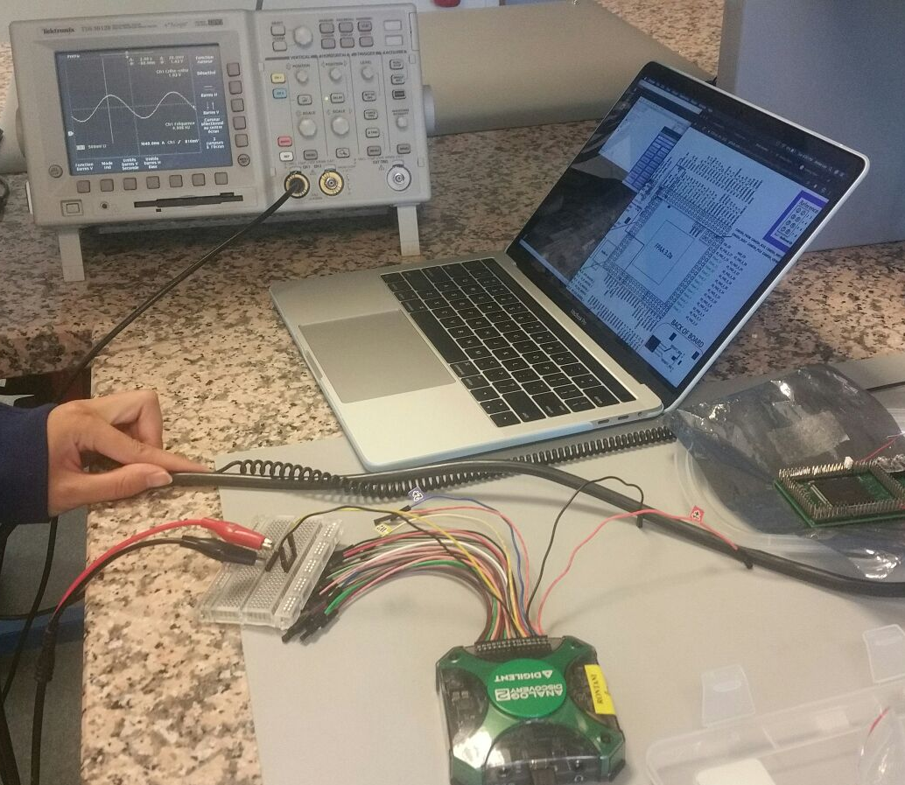
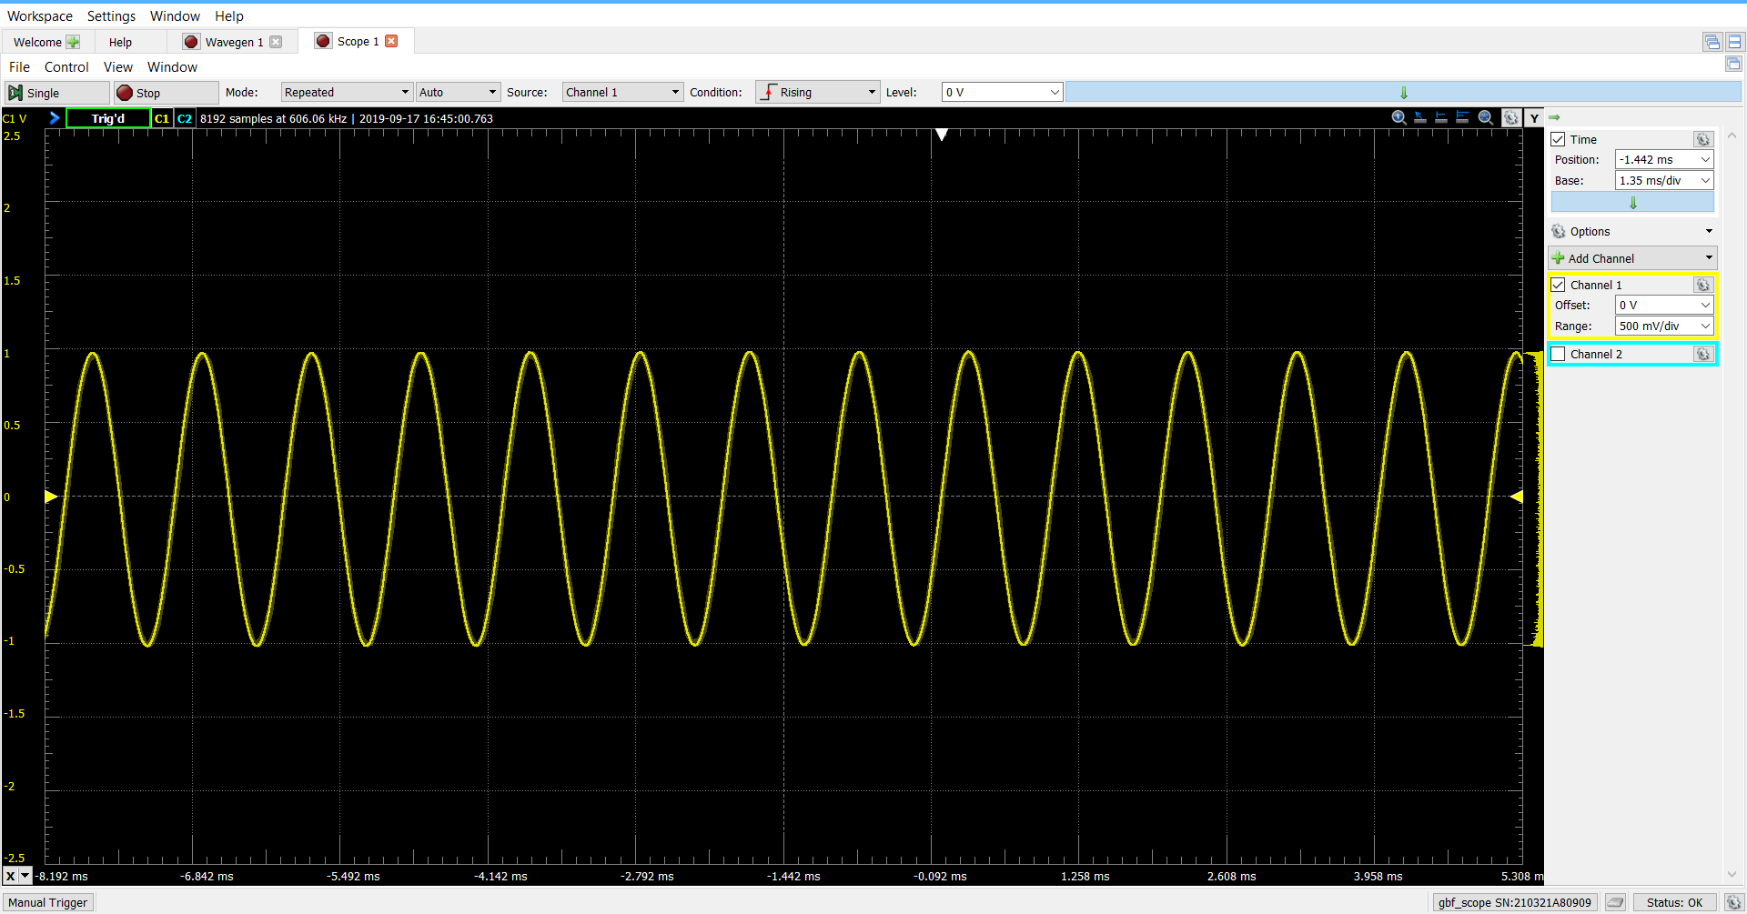
Getting familiar with Diligent’s tool – Analog discovery 2:
Followed tutorials & videos (lots of documentation)
Installed the ”Waveform” software
Calibrated the device
Played with wave generator & oscillator

Slide 3
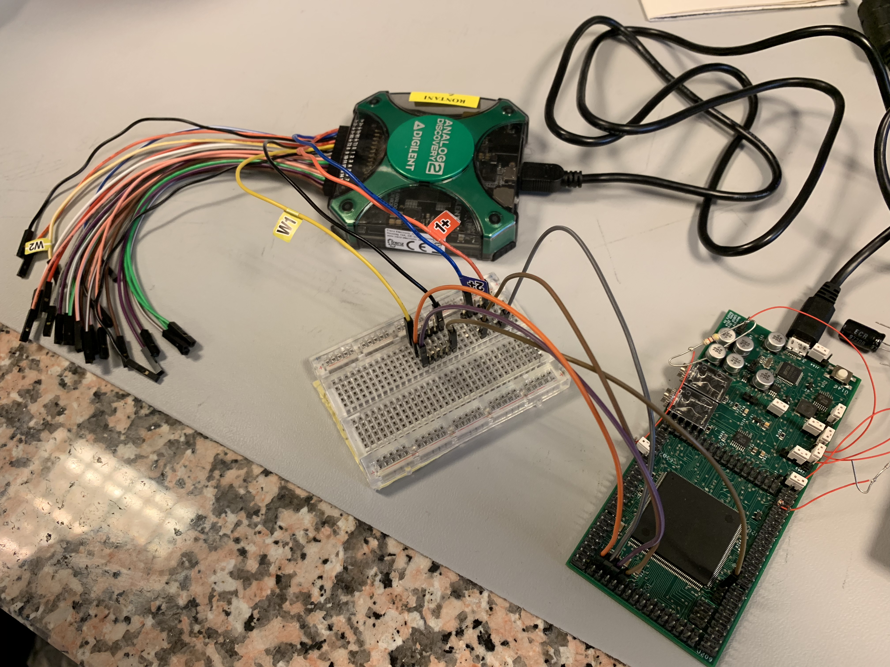
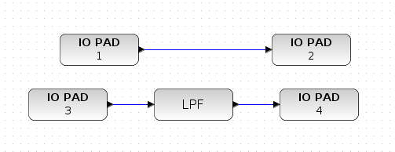
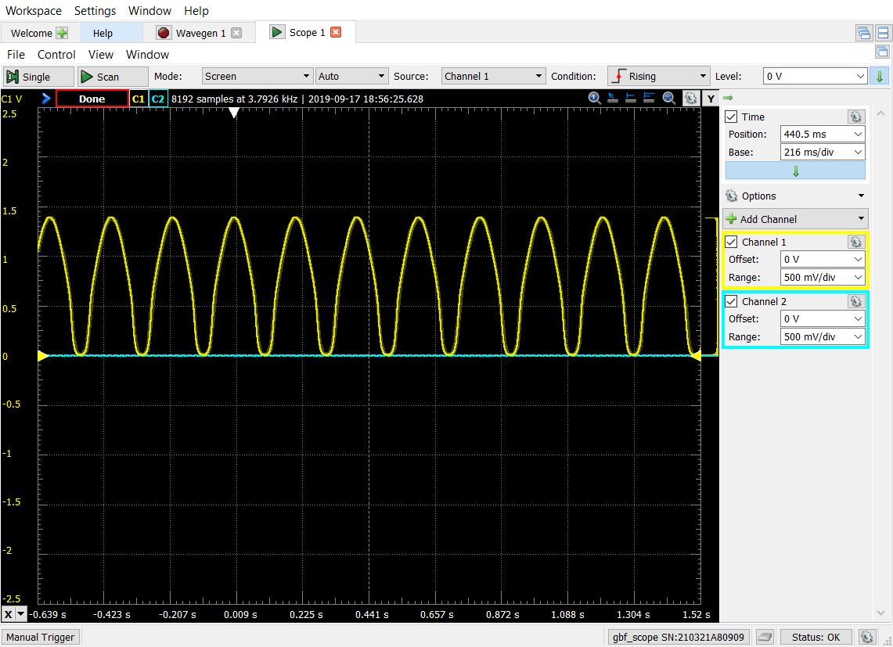
Testing off-chip designs
No available documentation (doesn’t open on the Blue GUI) on the pinout and on how to use the Digilent tool with the FPAA board => Annie and Anonto suggested they could write one for future teams
Hugo Schindler helped out and gave us access to the documentation that he had saved => it is now accessible on Github
So, eventually, we were able to make some off-chip tests:
The direct lecture of the input worked perfectly at first. But, after a few minutes the shape and amplitude of the output signal changed
The LPF function seemed to completely filter the signal out even though the cut-off frequency was set to 187Hz and the signal had a 5Hz frequency
This shows that the board is indeed not a plug-and-play device

Slide 4
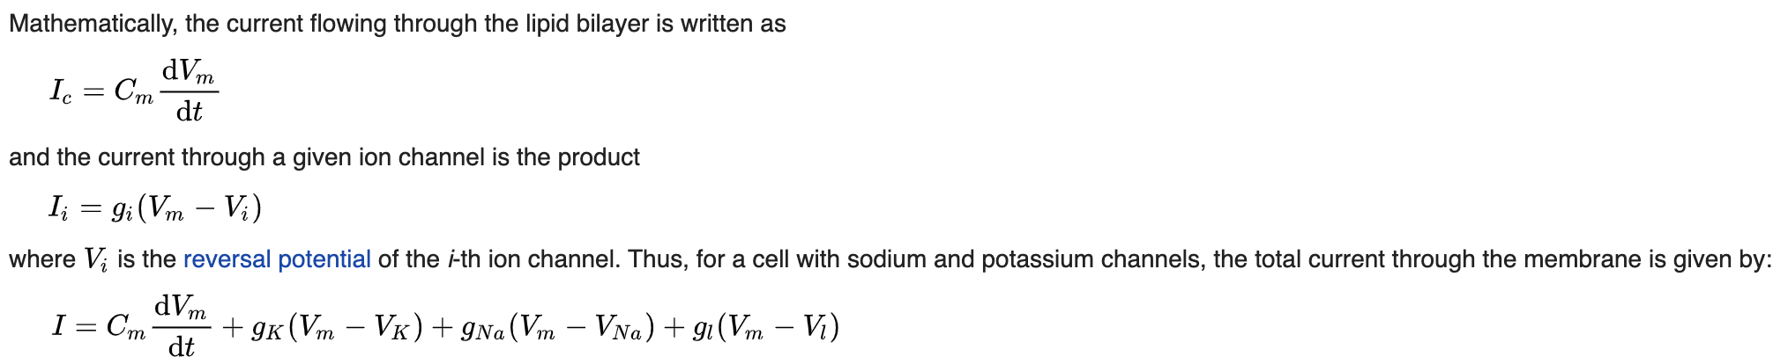

The Hodgkin-Huxley neuron model
We found a very interesting paper by Dr. Hasler on brain-inspired computing, which gives a good overview on the technology. However, we couldn’t find the documentation on her team’s implementation of the Hodgkin-Huxley neuron model.

Slide 5
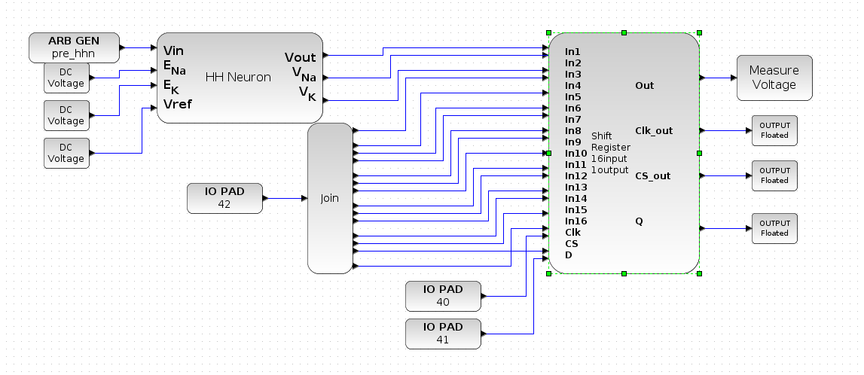
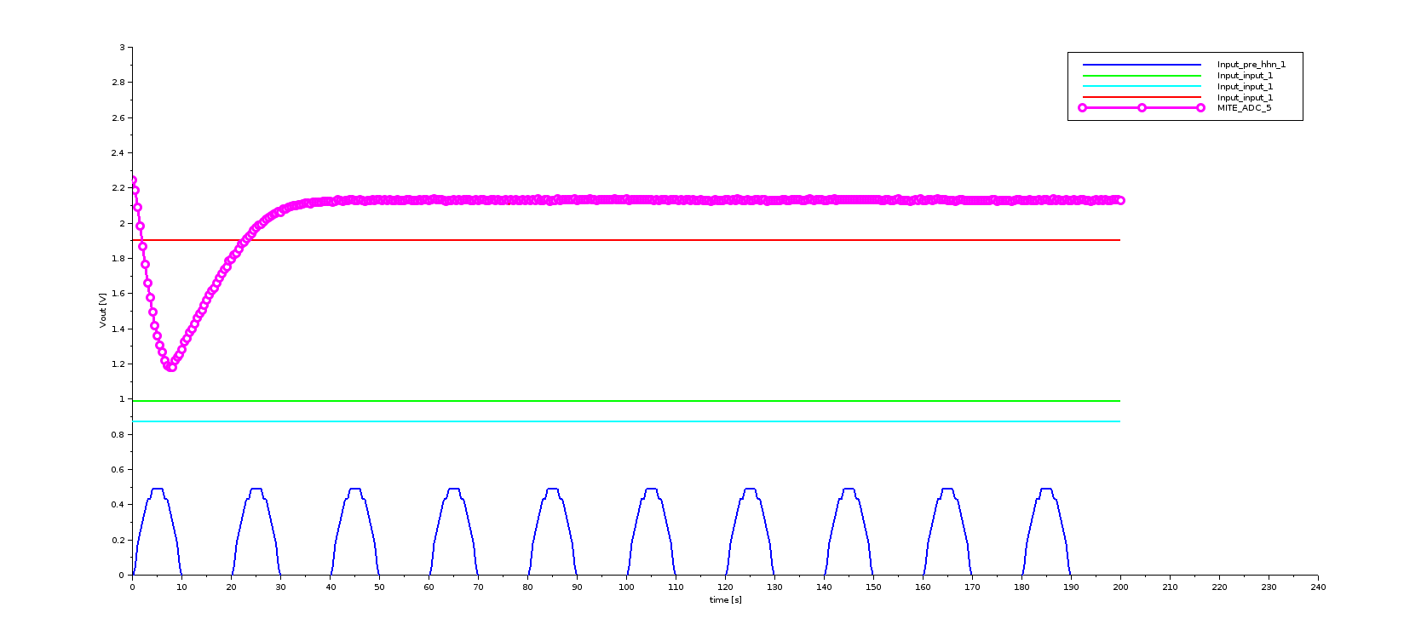
Testing the Hodgkin-Huxley neuron block
As we couldn’t find Dr. Hasler’s documentation on her team’s implementation of the Hodgkin-Huxley neuron yet, we haven’t really understood how this design works
The design mentions E_{Na}, E_{K}, V_{Na} and V_{K} so it is probably a simple Hodgkin-Huxley model using only Na and K ions
We tried testing it anyway to see if we could understand it empirically. We didn’t change the default values that were given in the design => the output is shown in the graph below
We tried inputting a sinusoidal function in the source block called “pre_hhn” and, later, a square signal: both gave the same output. This confirmed our assumption that the input signal should actually come from an external source (represented by the IO PAD blocks) and that this graph is the one obtained when there is no input signal
What does each input signal do?
What does the pre_hhn signal do?

